Slide 1

Building a Robust Hospital Management System
Presented by Ravikant Turi, Intern at Infinite Computer Solutions.

Slide 2
Project Overview & Core Technologies
Project Vision
Key Technologies
Our team project aims to streamline hospital operations, enhance data integrity, and improve administrative efficiency within a comprehensive Hospital Management System. My role specifically addresses critical admin functionalities: Pharmacy Approval and Insurance Management.
Java: Core programming language for business logic.
JSF (JavaServer Faces 2): Robust framework for the user interface.
Hibernate 3.6: ORM tool for seamless database interaction.
MySQL: Relational database for data persistence.
Architectural Foundation: MVC
Log4j 3.24: Logging utility for effective debugging and monitoring.
The system is built upon the Model-View-Controller (MVC) architectural pattern, ensuring a clear separation of concerns, modularity, and maintainability.

Slide 3
Module 1: Pharmacy Module
Admin Checks
Check Details
Automatic Emails
As an admin, my main job is to check and approve new pharmacy sign-ups. This step makes sure all pharmacies follow our rules and standards.
To approve a pharmacy, we check important details like their Pharmacy Name, Aadhaar Number, GST Number, and License Number. Our system automatically spots anything that doesn't meet the rules.
After we review an application, the system automatically sends an email to the pharmacy. This email tells them if they are approved or not and gives them clear next steps. It makes talking with applicants much faster.

Slide 4
Pharmacy Module: Data Validation Rules
Aadhaar Number Format
License Number Pattern
GST Number Structure
Must start with LIC followed by exactly 5 digits. Example: LIC12345
Requires GSTIN prefix, then 4 digits, and 2 alphanumeric characters. Example: GSTIN1234KP
Mandatory format: AADHAR followed by exactly 6 digits. Example: AADHAR123456
These stringent validation rules ensure data quality and compliance, preventing erroneous or fraudulent pharmacy registrations from entering the system. Robust exception handling is integrated for all validation failures.

Slide 5
Pharmacy Module: Database Schema
Pharmacy Details
Owner Details
pharmacy_id: VARCHAR(10) (Primary Key)
first_name: VARCHAR(100)
pharmacy_name: VARCHAR(100)
middle_name: VARCHAR(100)
contact_no: VARCHAR(15)
last_name: VARCHAR(100)
email: VARCHAR(100)
gender: VARCHAR(10)
password: VARCHAR(45)
owner_mobile: VARCHAR(20)
created_at: TIMESTAMP
owner_email: VARCHAR(100)
Location & Status
aadhar: VARCHAR(20)
owner_address: VARCHAR(255)
state: VARCHAR(50)
This schema organizes critical pharmacy information, ensuring comprehensive data management for the Approval System.
city: VARCHAR(100)
pin_code: VARCHAR(10)
address_line1: VARCHAR(255)
license_no: VARCHAR(20)
status: VARCHAR(20)
gst_number: VARCHAR(20)

Slide 6
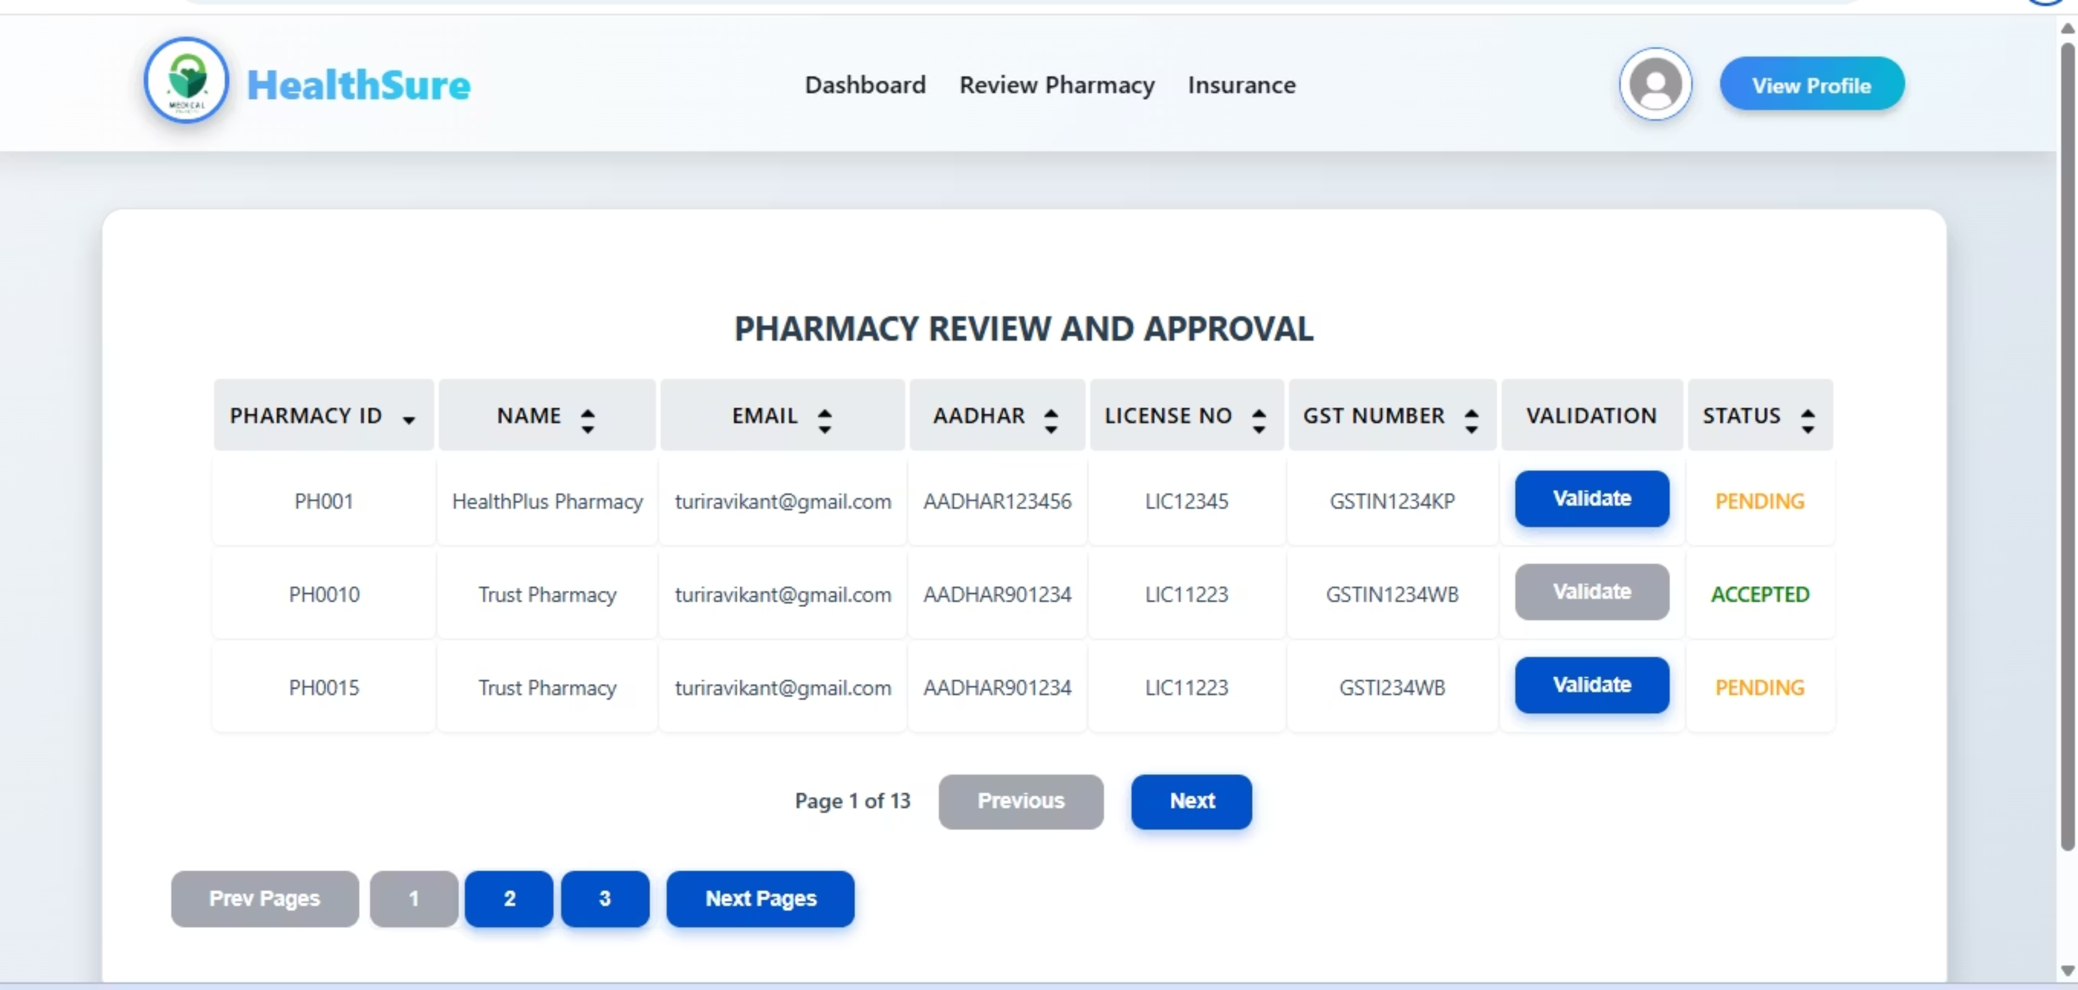
Pharmacy Module: User Interface
The user interface for the Pharmacy Approval module is designed for administrators to efficiently manage registrations. It features a searchable, sortable, and paginated table view of all pharmacies, along with clear visual indicators for approval status.

Slide 7



Module 2: Create Insurance
Insurance Plan Structure
Admins can efficiently create and manage insurance plans, ensuring flexible coverage and adherence to regulations. This includes:
Plan Creation: Admins can define new insurance plans, specifying options such as Silver, Gold, and Platinum, each with distinct benefits and coverage levels.
Member Types: Plans can be configured for individual or family coverage, allowing admins to set rules for the number of members per plan.
Member Relations: The system enables admins to define and manage relationships between policyholders and their family members (e.g., spouse, child), ensuring accurate coverage and claim processing.
Plan Coverage options
Silver Plan
Gold Plan
Platinum Plan

Slide 8
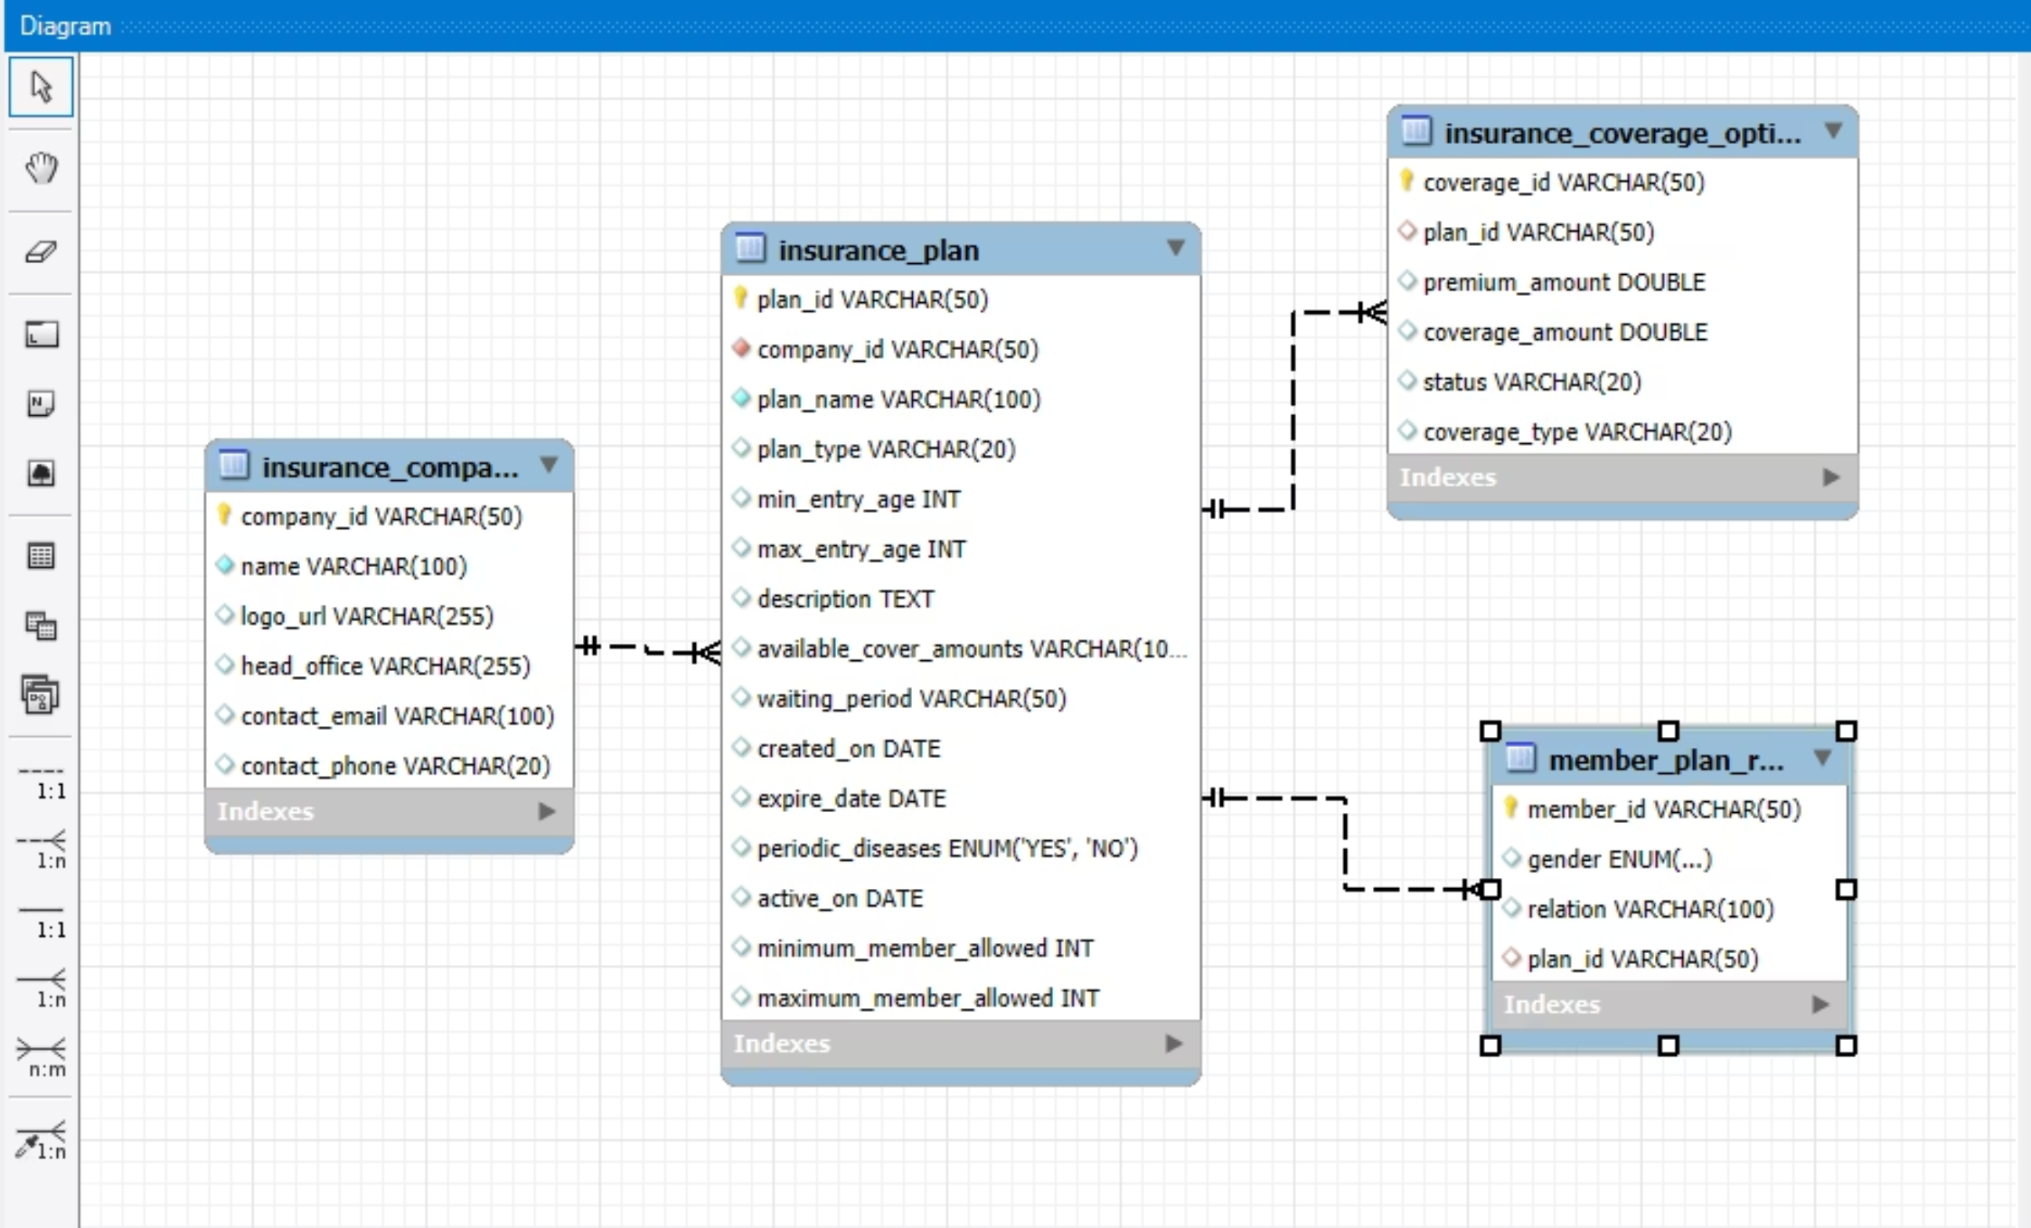
Insurance Module: Database Schema

Slide 9
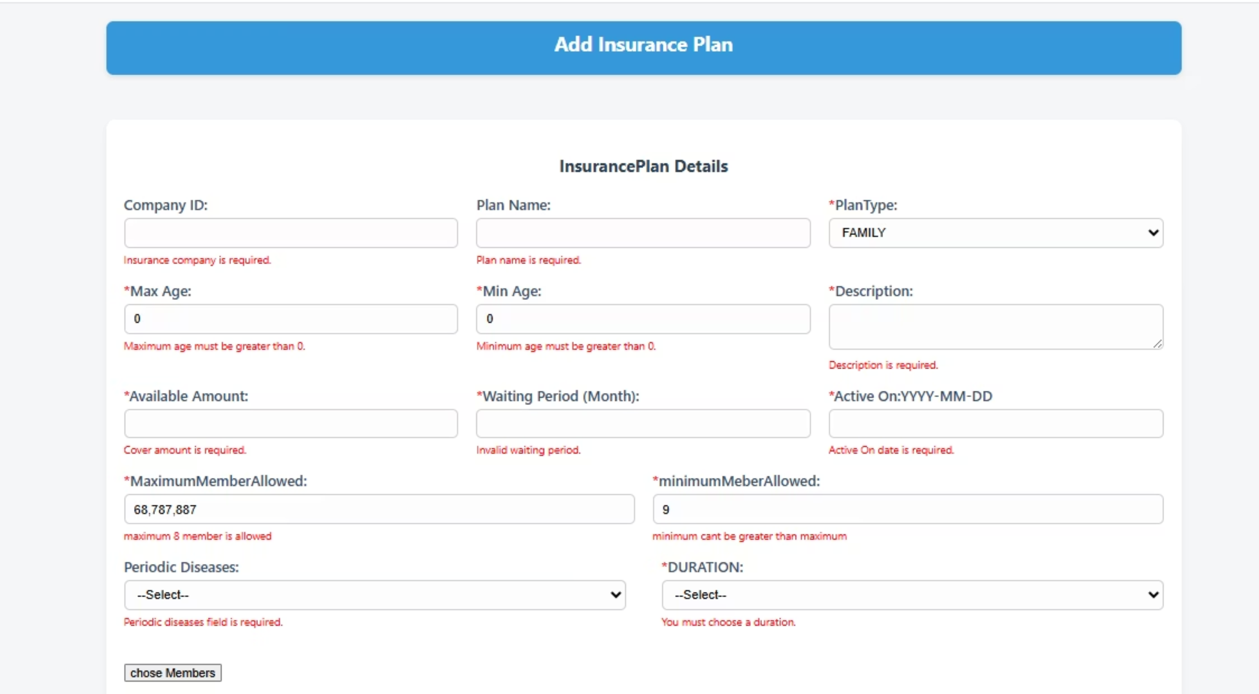
Insurance Module: User Interface
The Insurance Management dashboard offers administrators a centralized view of all active insurance plans. Its user-friendly interface supports adding new plans, editing existing ones, and efficiently searching, sorting, and paginating through the insurance data to maintain an organized and up-to-date record of all offerings.

Slide 10
Conclusion: Enhancing Hospital Operations
In summary, this project successfully developed and integrated crucial administrative modules for pharmacy approval and insurance management. These advancements significantly improve daily hospital operations by streamlining key processes, reducing errors, and enhancing the overall efficiency and accuracy of healthcare services.
1
Integrated Modules
2
Easy Pharmacy Approvals
We successfully built important admin tools for pharmacy approvals and managing insurance plans.
Admins can now quickly approve new pharmacy registrations.
3
Simple Insurance Setup
4
Smoother Hospital Work
Administrators can easily create and manage various insurance plans, making patient coverage more flexible and accurate.
These new tools make hospital operations much more efficient, cut down on manual mistakes, and create a strong base for connected healthcare.

